Slide 1
Company All-Hands
July 2026 · Berlin and Limassol

Slide 2

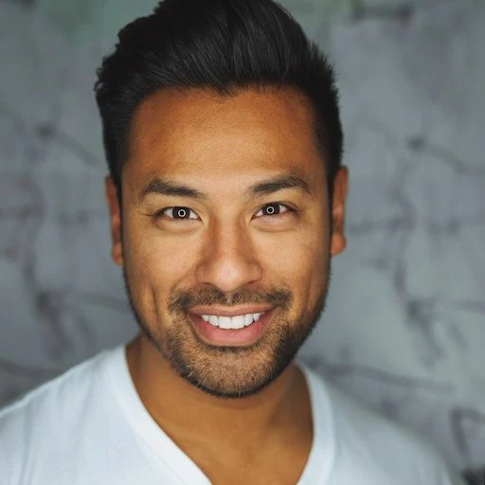
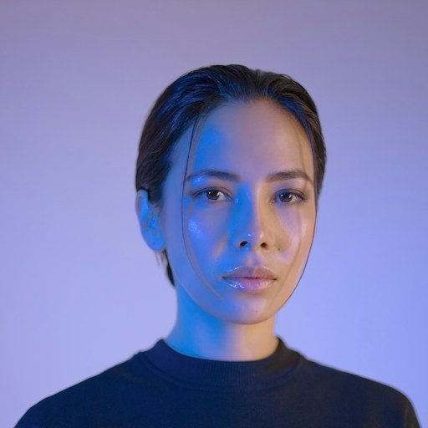
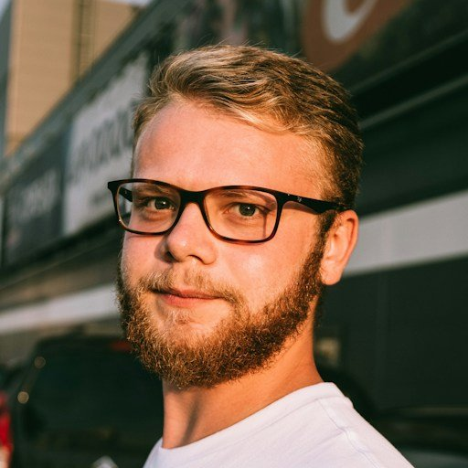
Welcome to the team
Sofia Andersen · Design
Lucas Costa · Sales
Mia Nakamura · Engineering
Felix Berg · Support

Slide 3
Q2 by the numbers
• Revenue up 42% year over year
• 318 active users across 6 workspaces
• Share links with PIN shipped on time
• Two incidents, both resolved within an hour

Slide 4

Limassol office
• Lease signed, fit-out starts in September
• Forty desks, opening Q4 2026
• Relocation support available, ask HR
Building on the old harbour

Slide 5
What is next
• Content search GA
• Desktop sync client beta
• Company offsite in October

